Slide 1


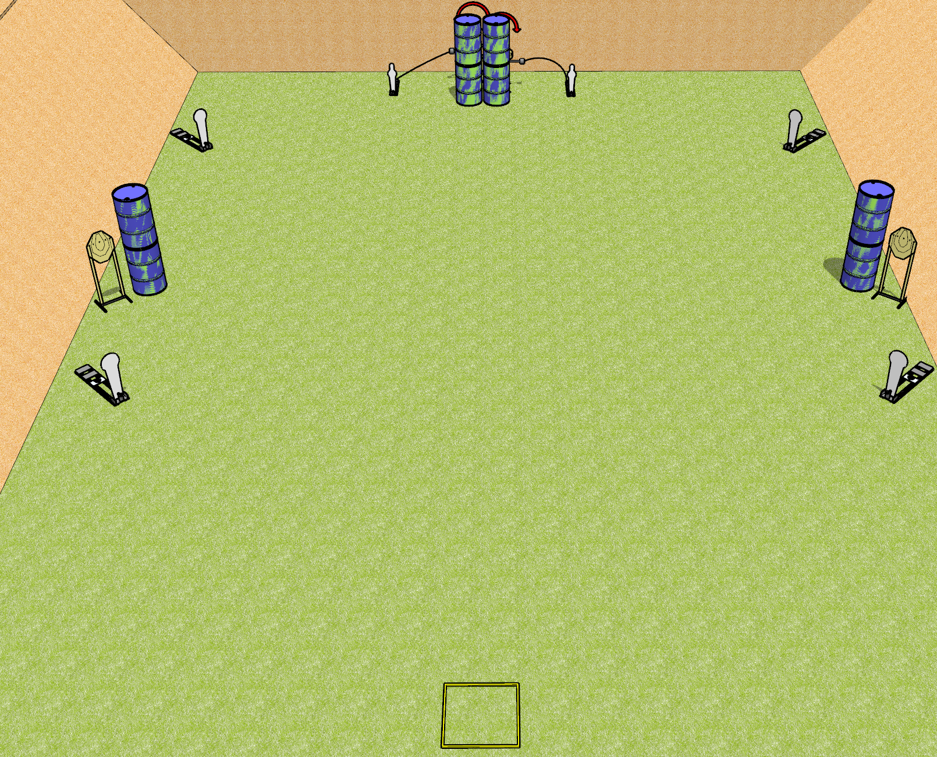
 | Dothan Gun Club – USPSA Match Quickness Course Designer : Drew Coleman
Round Count 14 rounds 4 IPSC targets 4 colt poppers, 2 USPSA mini poppers
Equipment List 2 swingers + activators Shooting box Barrels near the static paper are spall protection – look at setup and use if needed

Slide 2
Quickness
Written Stage Briefing
Quickness is a 14 round, 70 point, Comstock speed shoot. There are 4 IPSC targets, 4 colt poppers, and 2 USPSA mini poppers. The best 2 hits on paper will score, and steel must fall to score. The start signal is audible.
The left swinger is activated by the left mini popper, and the right swinger is activated by the right mini popper. Please check the activators prior to walkthrough and set them the same way every time.
Handgun start position is in shooting box, wrists below belt. Handgun is loaded and holstered.
PCC start position is in shooting box. Loaded carbine is held with both hands, stock on belt, safety on.
On start signal, engage the left poppers and static paper OR the right poppers and static paper, then perform a mandatory reload and engage the remaining array. The swingers may be engaged at any time. Failure to perform a mandatory reload will incur a procedural penalty per shot fired until the reload is completed.

Slide 3
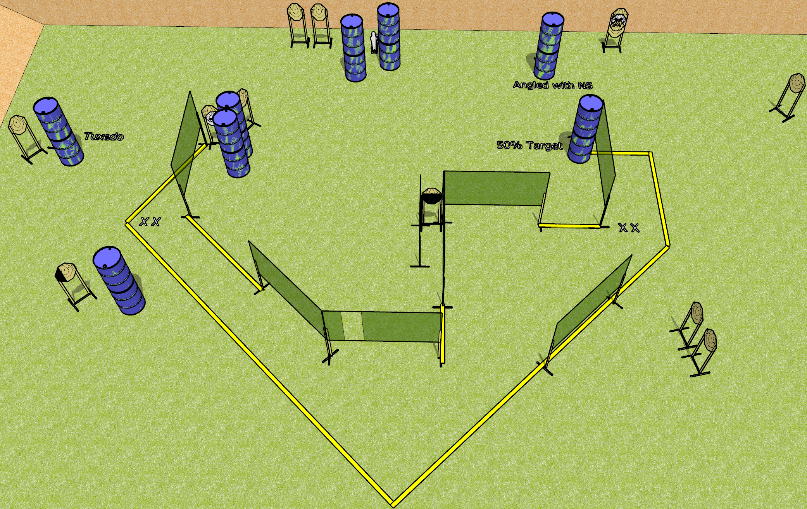
 | Dothan Gun Club – USPSA Match Flights of Fancy Course Designer : Drew Coleman
Round Count 31 15 ISPC 1 Mini popper
Equipment List 3 medium fault lines 15 wall feet

Slide 4
Flights of Fancy
Written Stage Briefing
Flights of Fancy is a 31 round, 155 point, Comstock field course. There are 15 IPSC targets and 1 mini popper. The best 2 hits on paper will score, and steel must fall to score. The start signal is audible.
Handgun start position is both feet on either set of X’s, wrists below belt. Handgun is loaded and holstered.
PCC start position is both feet on either set of X’s. Loaded carbine is held with both hands, stock on belt, safety on.
On start signal, engage targets as they become available from within the shooting area.

Slide 5
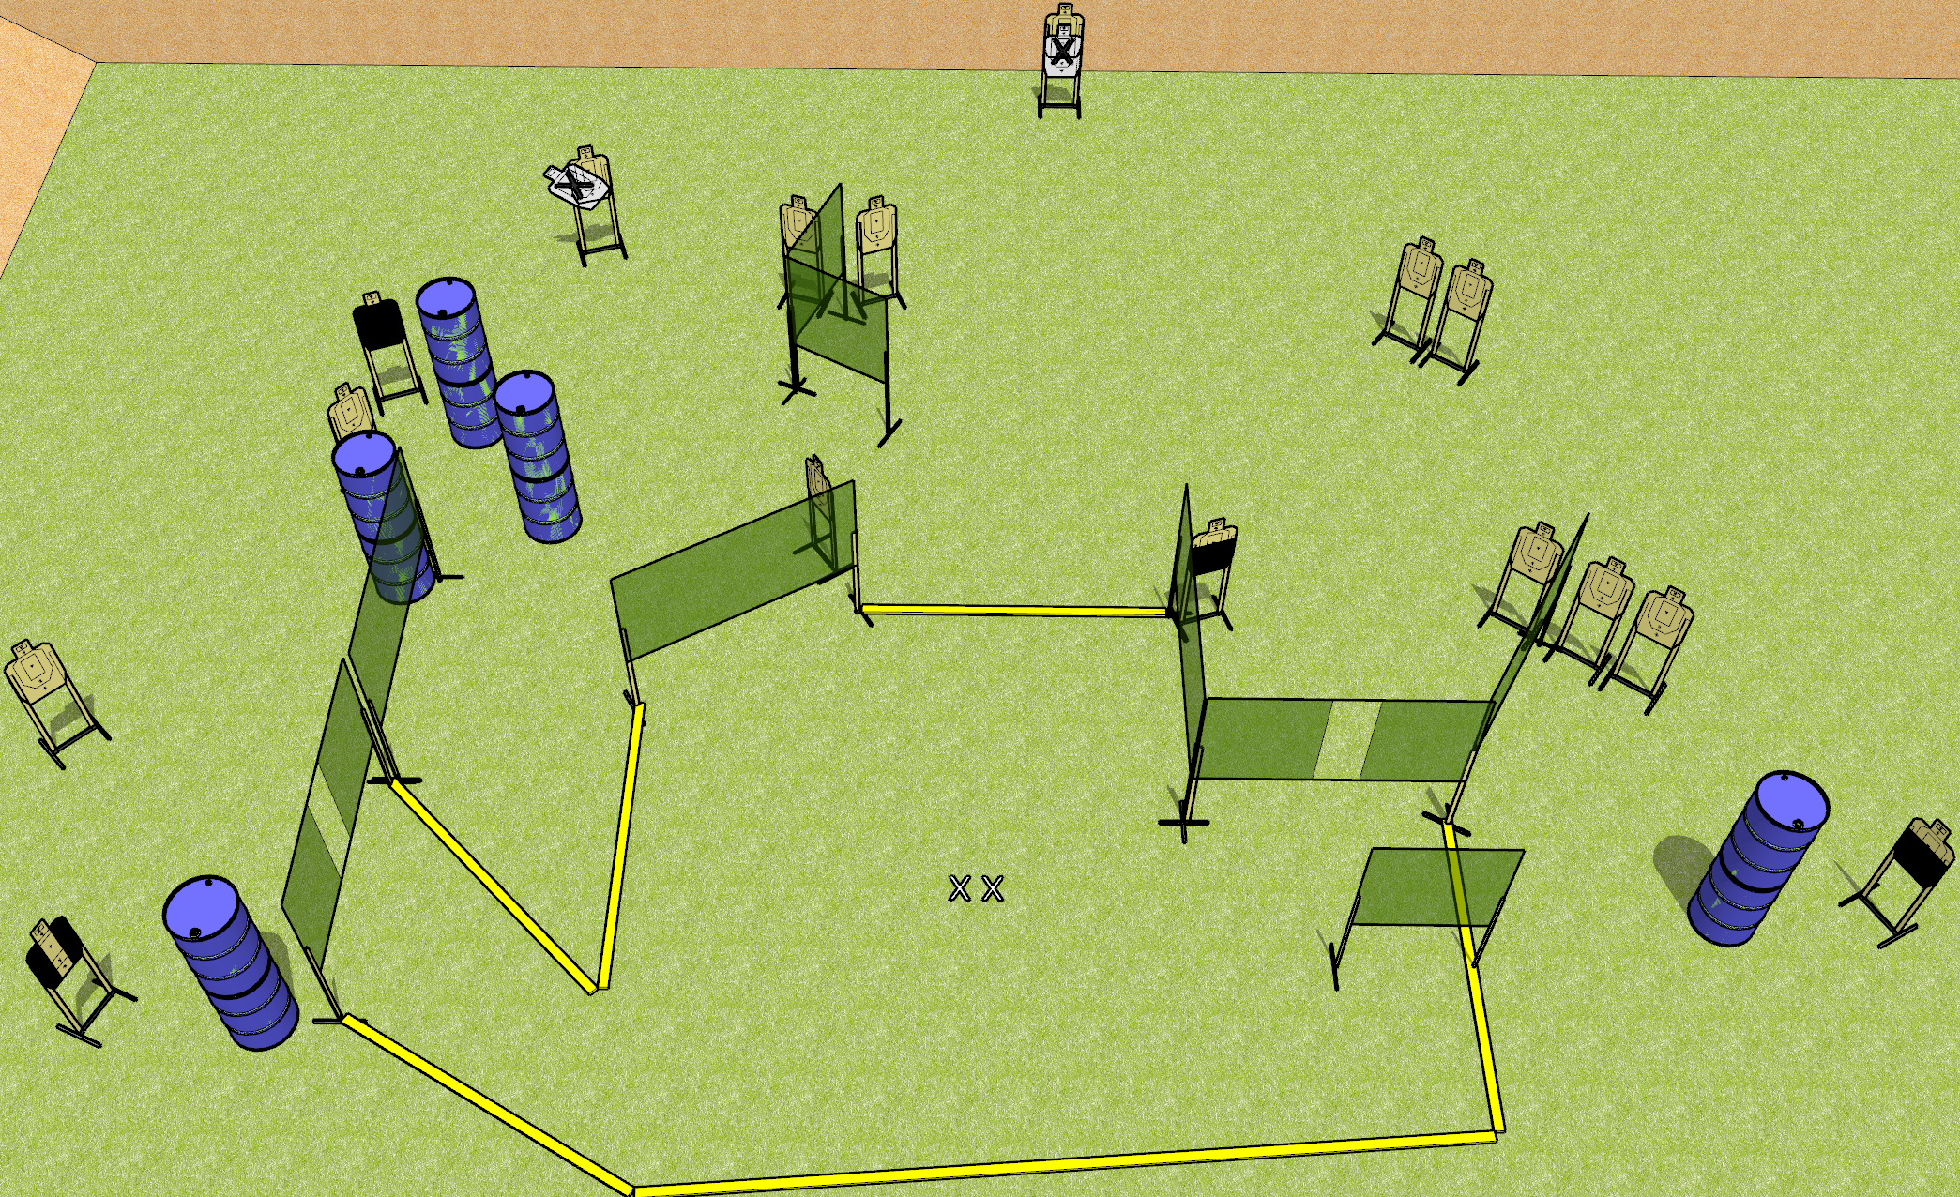
 | Dothan Gun Club – USPSA Match Sweet Dreams Course Designer : Drew Coleman
32 rounds 16 USPSA targets
Equipment List 15 wall feet 1 tuxedo, 2 50% OR action target, 1 headshot

Slide 6
Sweet Dreams
Written Stage Briefing
Sweet Dreams is a 32 round, 160 point, Comstock field course. There are 16 USPSA targets. The best 2 hits on paper will score, and steel must fall to score. The start signal is audible.
Handgun start position is both feet on X’s, wrists below belt. Handgun is loaded and holstered.
PCC start position is both feet on X’s. Loaded carbine is held with both hands, stock on belt, safety on.
On start signal, engage targets as they become available from within the shooting area.

Slide 7
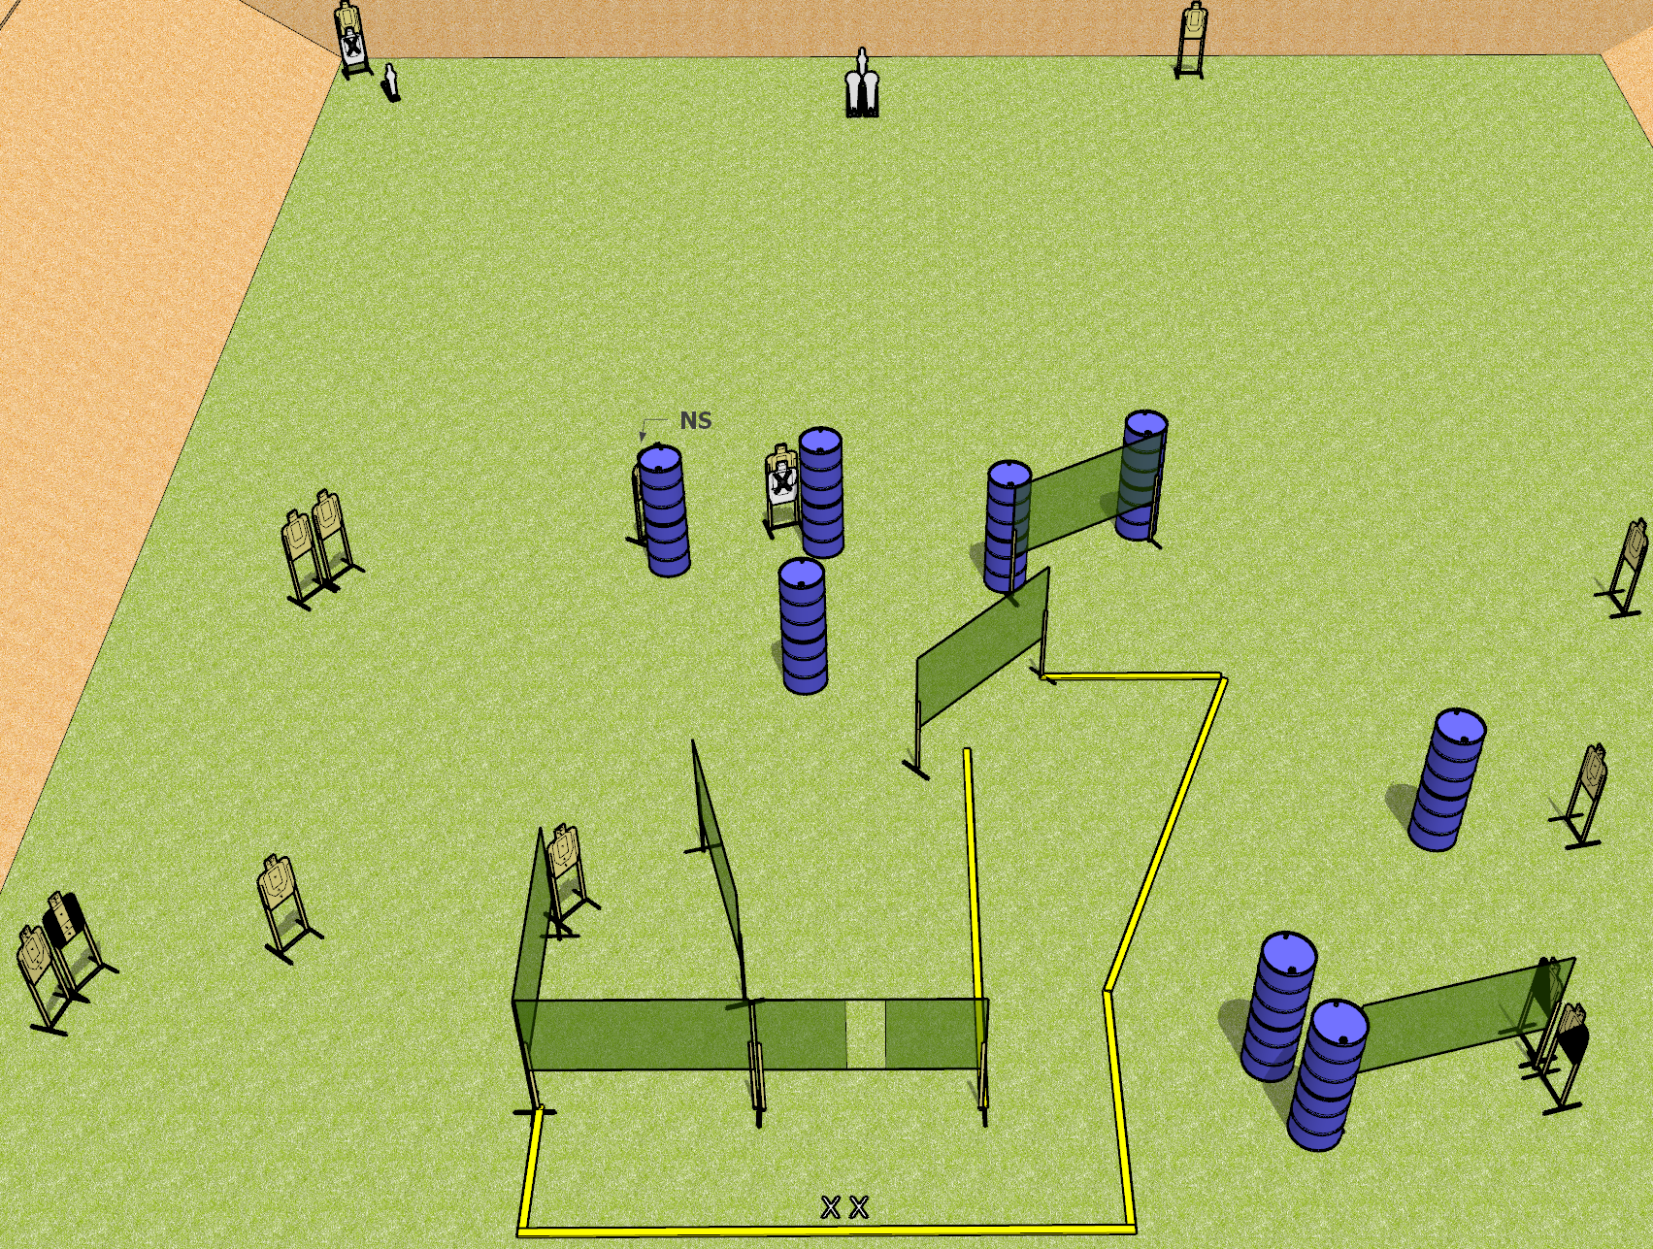
 | Dothan Gun Club – USPSA Match Mom’s Spaghetti Course Designer : Drew Coleman
Round Count 32 rounds 14 USPSA targets 2 colt poppers, 2 USPSA mini poppers
Equipment List 12 wall feet 2 Tuxedos, 1 left diagonal, 1 right diagonal

Slide 8
Mom’s Spaghetti
Written Stage Briefing
Mom’s Spaghetti is a 32 round, 160 point, Comstock field course. There are 14 USPSA targets, 2 colt poppers, and 2 USPSA mini poppers. The best 2 hits on paper will score, and steel must fall to score. The start signal is audible.
Handgun start position is both feet on X’s, wrists below belt. Handgun is loaded and holstered.
PCC start position is both feet on X’s. Loaded carbine is held with both hands, stock on belt, safety on.
On start signal, engage targets as they become available from within the shooting area.

Slide 9
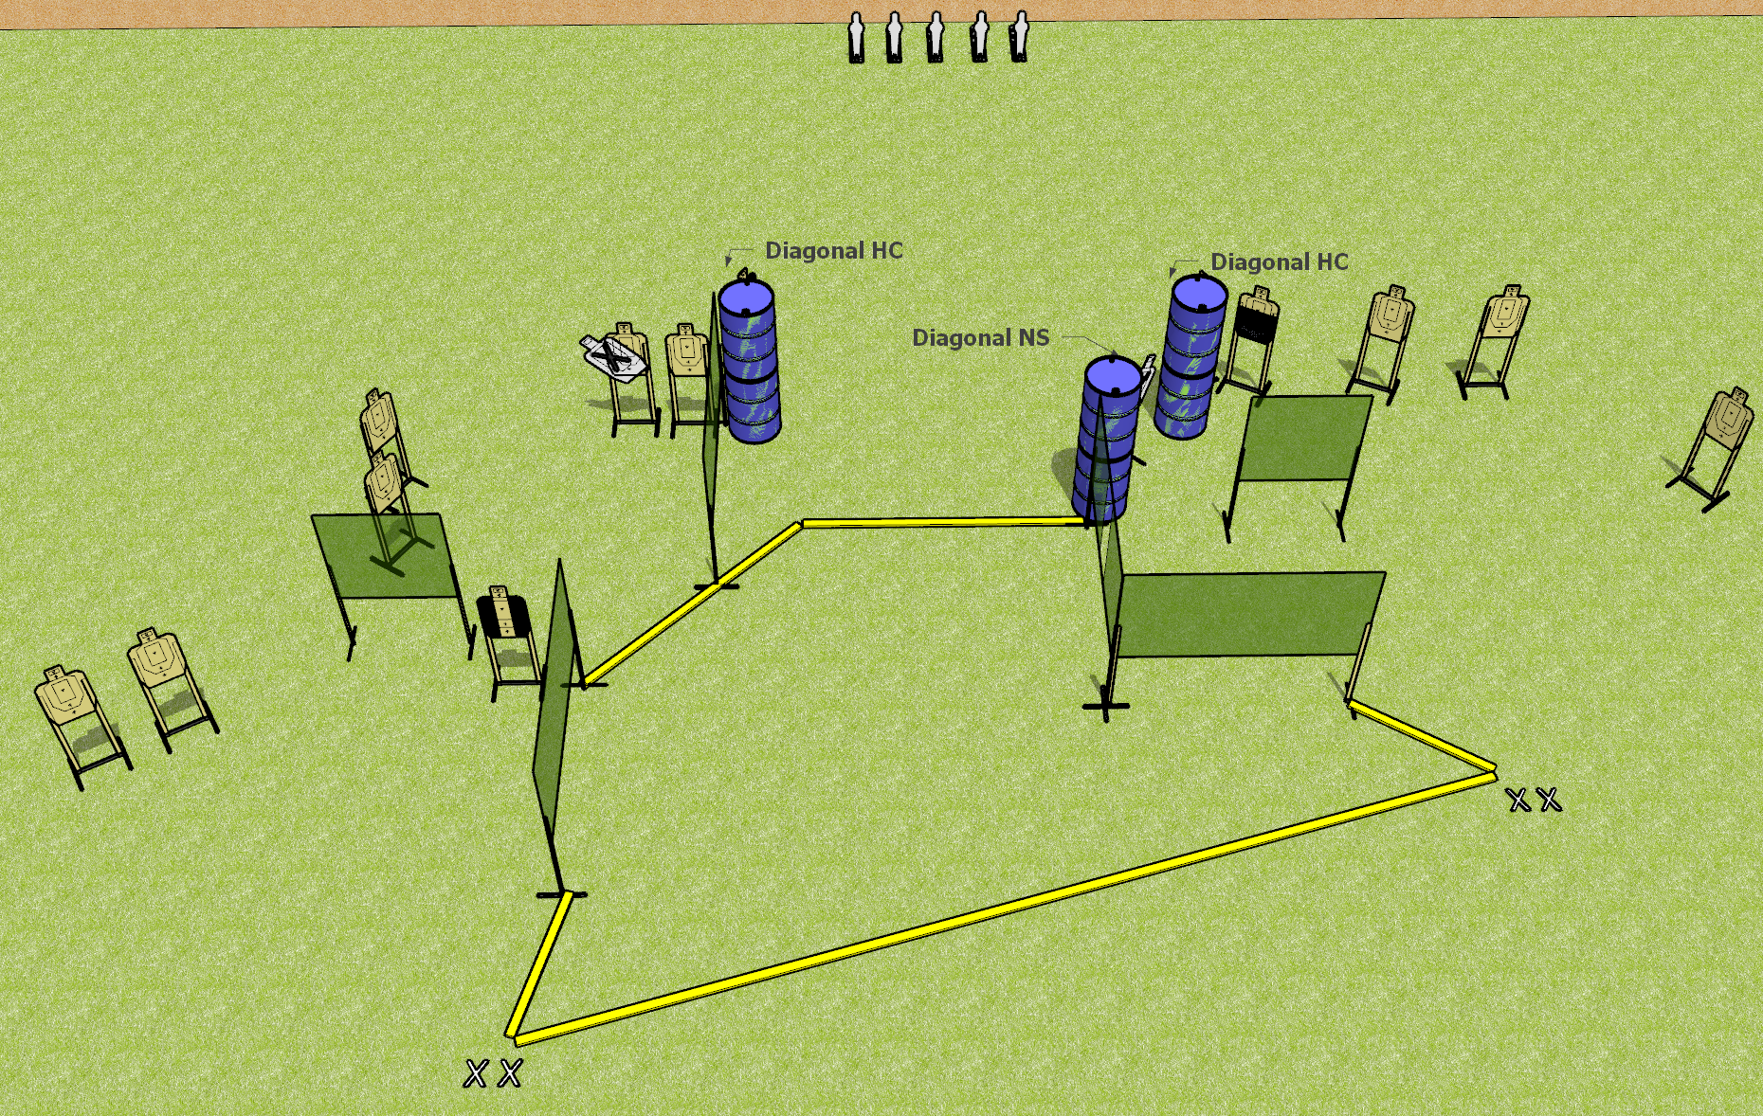
 | Dothan Gun Club – USPSA Match Fun in the Sun Course Designer : Drew Coleman
Round Count 33 rounds 14 USPSA targets 5 USPSA mini poppers
Equipment List 11 wall feet 1 tuxedo, 1 left diagonal and 1 right diagonal, 1 50%

Slide 10
Fun in the Sun
Written Stage Briefing
Fun in the Sun is a 33 round, 165 point, Comstock field course. There are 14 USPSA targets and 5 USPSA mini poppers. The best 2 hits on paper will score, and steel must fall to score. The start signal is audible.
Handgun start position is both feet on either set of X’s, wrists below belt. Handgun is loaded and holstered.
PCC start position is both feet on either set of X’s. Loaded carbine is held with both hands, stock on belt, safety on.
On start signal, engage targets as they become available from within the shooting area.

Slide 11
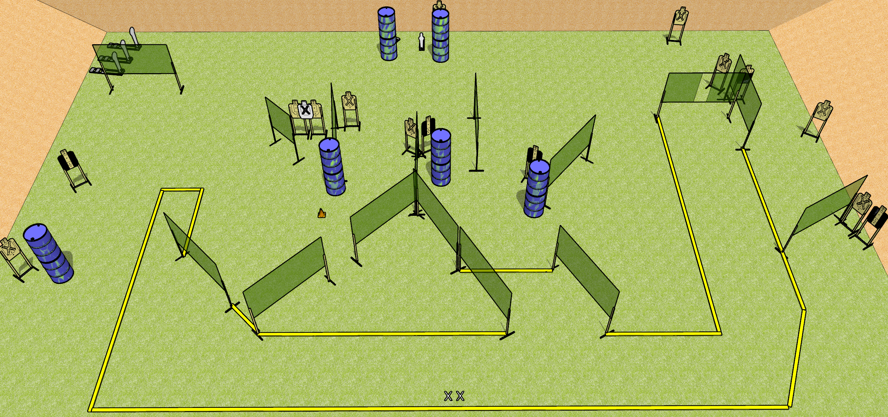
 | Dothan Gun Club – USPSA Match Bring Your A-Game Course Designer : Drew Coleman
Round Count 35 rounds 15 USPSA targets 3 colt poppers, 2 USPSA mini poppers
Equipment List 26 wall feet Setup Note: there’s a mini behind the left set of barrels by the berm, and a paper target behind the other set to the right.

Slide 12
Bring Your A-Game
Written Stage Briefing
Bring Your A-Game is a 35 round, 175 point, Comstock field course. There are 15 USPSA targets, 3 colt poppers, and 2 USPSA mini poppers. The best two hits on paper will score, and steel must fall to score.
Handgun start position is both feet on X’s, wrists below belt. Handgun is loaded and holstered.
PCC start position is both feet on X’s. Loaded carbine is held with both hands, stock on belt, safety on.
On start signal, engage targets as they become available from within the shooting area.

